Slide 1
Using Textual Analysis to Explore Symbolic and
Material Interactions between the Sharing Economy and Urban Space
Frances Chen, SuYeong Shin, Jeff Sternberg, Kartik Trivedi, Yilei Zeng
(in alphabetical order)

Slide 2
Research Question
How are representations of a place (neighborhood) leveraged differently by various actors in the same shared space (i.e., traditional business like restaurants, sharing economy actors like Airbnb listers, airbnb lodgers,etc)?
Notes:
Term definition, city actor

Slide 3
Literature Review
City Image
City image as compilation of all residents’ experienced mental maps of the city - Kevin Lynch, The Image of the City (1960), De Certau
Changing Contexts and Elite Authors of City Image
City Elites and Growth Machines - John Logan and Harvey Molotch 1987; Logan 1976; Molotch 1976, The City as Growth Machine (1976)
Transition of Cities from Keynesian managerialism to neoliberal entrepreneurialism, City Marketing - David Harvey 1989, 1992;
Who consumes City Image and sets its Standards?
City image as fractured among different actors and their social networks - Sevin 2014
Creative and Global Cities set standard criteria for how city images are constructed and evaluated - Florida 2001, 2003 and Sassen 2001
City Image created for people who do not live in the city, to attract talent and capital - Ong 2007, Vanolo 2015
The Overall Function of City Image
City images become a key mechanism in converting the use value of place into exchange value, into commodifying the urban space of the city into a consumable commodity - Lefebvre 1991

Slide 4
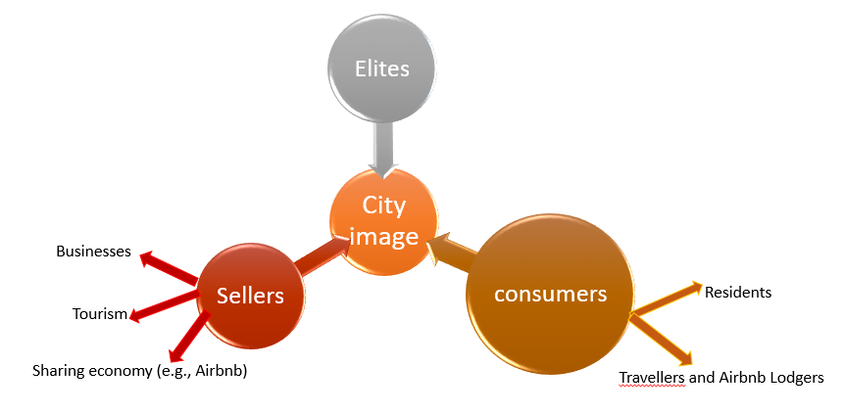
Actors of City Image
Notes:
This is the most studied level of city image
Macro, mass media effects
Most outward facing

Slide 5
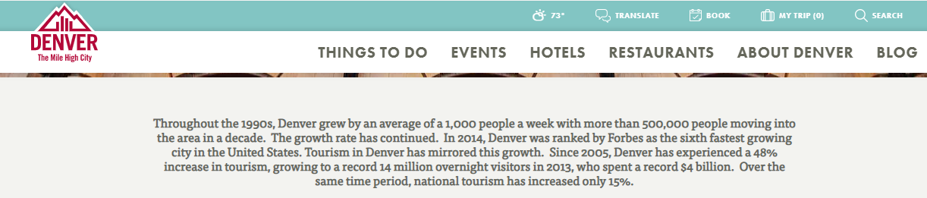
Elite-Crafted City Image

Slide 6
Dream Data
What We Wanted
Airbnb, Uber, Trip Advisor, Eventbrite, FourSquare, Yelp, Census, ACS, Google Maps
What We Couldn’t Get
Uber, Trip Advisor, FourSquare, Eventbrite
What We Ended Up With
Airbnb, Census, Yelp, Google Maps

Slide 7
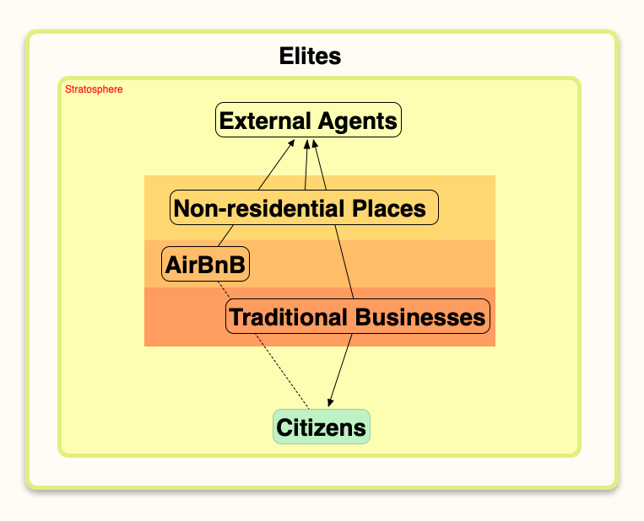

Framework

Slide 8
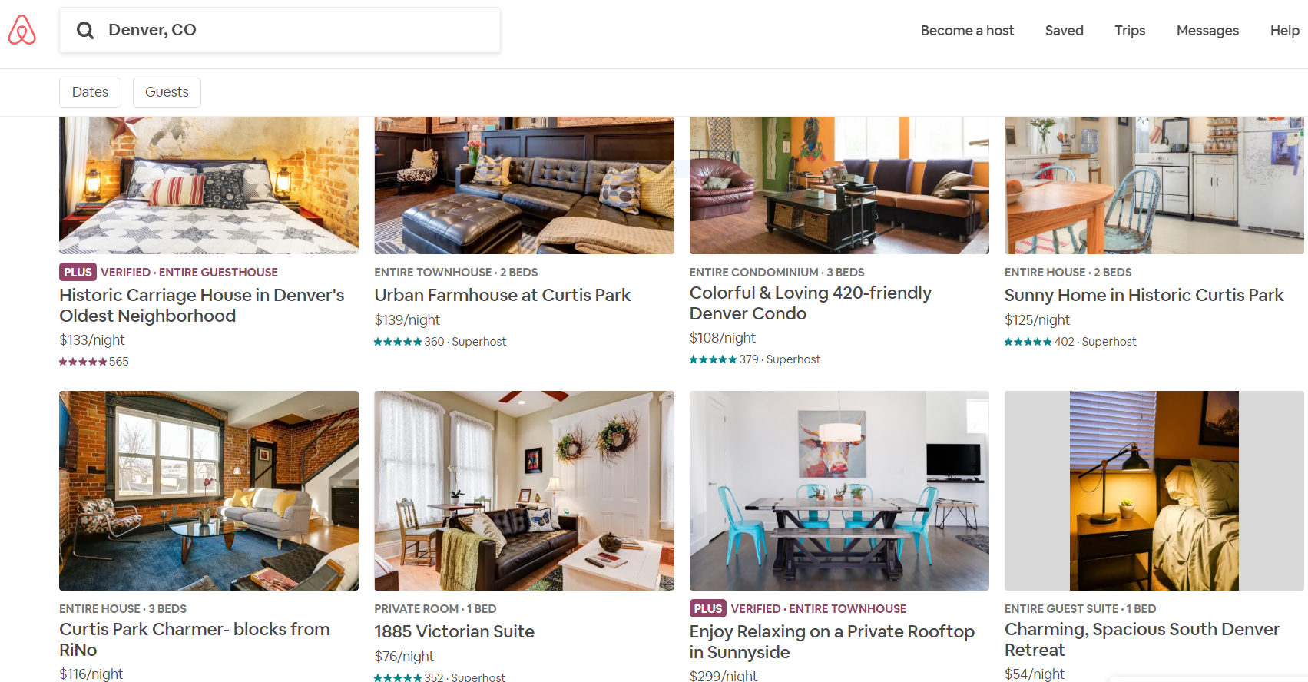
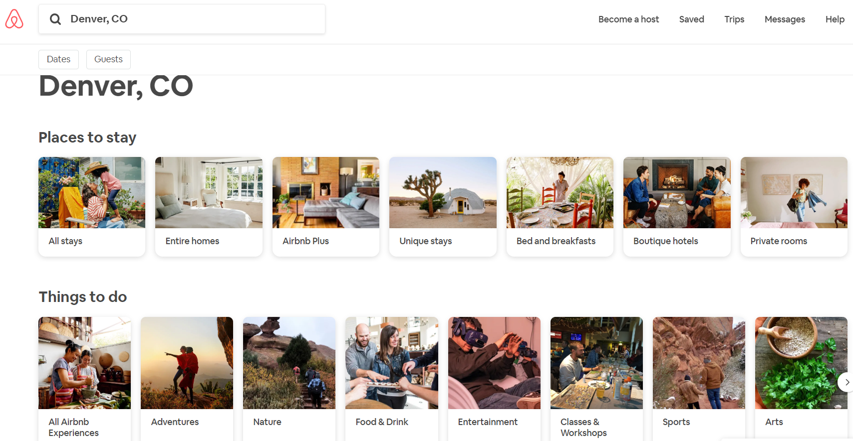
Why Denver?
“Ordinary” cities
Not a Global City on the scale of NYC, LA, Chicago, SF
Relatively young city going through growth pangs
Music & tech-oriented labor force
e.g. Austin, Denver, & Portland
Denver
One of the prominent cities in the western part of the US
Average sized city with a total area of 155m² and a population of 619,968.

Slide 9
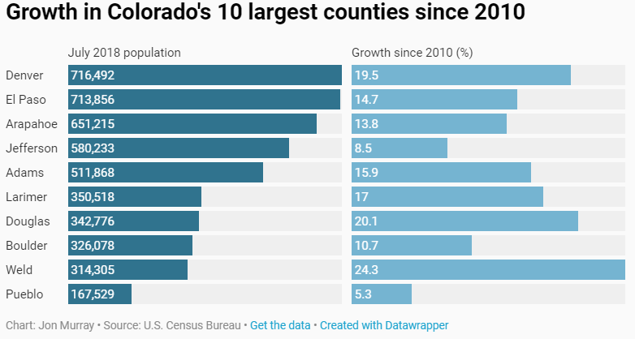
Growth of Denver
Rapid population growth
increased by ~20% since 2010
Small business growth
The top-ranked metro for small business employment growth (as of March 2018)
Hourly earnings growth among small business workers: increased 3.27% in 2018 to $29.43. (national: 2.66%, $26.48)
Tourism growth
Since 2005, 48% increase in tourism (national: 15%)
Advantage of using the Denver case:
The dynamism of a city
Urban boom a housing affordability crunch, increased traffic
Higher incidence of peer-to-peer economic exchange in the sharing economy.
https://www.bizjournals.com/denver/news/2018/04/05/denvers-tops-in-the-nation-for-small-business.html
https://www.denverpost.com/2019/04/18/denver-population-growth-census/
Notes:
Denver's tops in the nation for small-business growth in March, according to the latest Paychex | IHS Markit Small Business Employment Watch report
Throughout the 1990s, Denver grew by an average of a 1,000 people a week with more than 500,000 people moving into the area in a decade. The growth rate has continued. In 2014, Denver was ranked by Forbes as the sixth fastest growing city in the United States. Tourism in Denver has mirrored this growth. Since 2005, Denver has experienced a 48% increase in tourism, growing to a record 14 million overnight visitors in 2013, who spent a record $4 billion. Over the same time period, national tourism has increased only 15%.

Slide 10
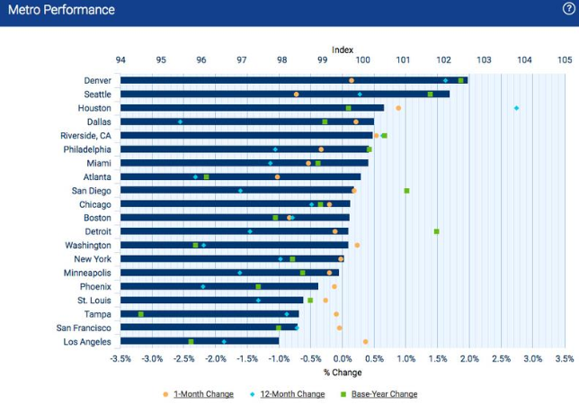

Slide 11
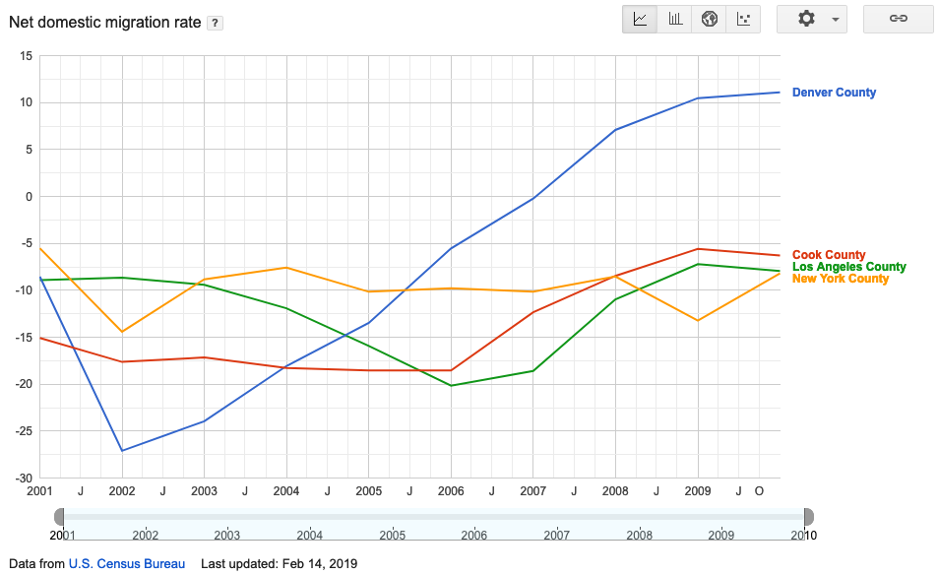
Net Migration Rate
Notes:
https://www.google.com/publicdata/explore?ds=kf7tgg1uo9ude_&ctype=l&strail=false&bcs=d&nselm=h&met_y=RDOMESTICMIG&scale_y=lin&ind_y=false&rdim=country&idim=county:08031:17031:36061:06037&ifdim=country&hl=en&dl=en&ind=false

Slide 12
Airbnb: Place-based Commodities
Datasource: Official Airbnb released Data, simple extraction
How much do we rely on company released data? (http://insideairbnb.com/index.html)
Released roughly every 6 months going back until May 2016
Separate Listing and Review Datasets with both meta-data and text
Sample meta-data: rating, price, availability, host since, listing count
We are linking the review data to the listings they are reviewing
Gives us a view of the new actors brought in by the sharing economy and entering the arena of city-image construction and consumption

Slide 13
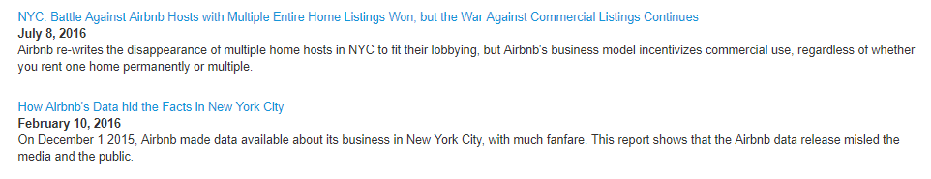

Slide 14
Census:
Local neighborhood characteristics
Data source: American Community Survey (ACS) and decennial census (2010)
ACS: 5-year, 3-year, & 1-year version (defined by endyear)
Unit: census tract (? vs. organic neighborhood)
Example variables of the local neighborhood (computed):
Population (size, race makeup, age, sex),
socioeconomic feature (median household income, % under poverty),
vacancy %
housing/family features (rent/own, husband-wife vs. male vs. female family)
Data extraction effort
web -based vs. API (acs vs. tidycensus): trial and errors
Difficulties and solutions (variables # and labels)

Slide 15
Google Earth and Google Maps Places API
Google Earth provides map visualization tools as well as map parser so that we were able to derive the exact longitude and latitude coordinates of all 144 census tracts in Denver city.
To break through the Google API limit, each census tracts with its longitude and latitude boundaries are then evenly divided into grids by our python program. We use the center point coordinate of each grid to call google places API. This first round query will give us a complete ID list of all 90 types of places in the area.
Given the ID list, we will then need to perform second round query through the place detail API to get up to 5 reviews of each place.
A grid search algorithm is then designed to label each place’s to its exact census tract.

Slide 16
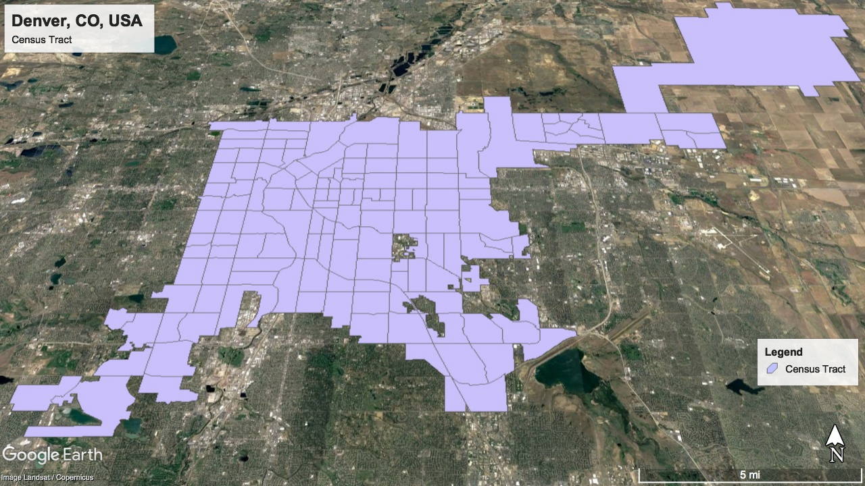

Slide 17
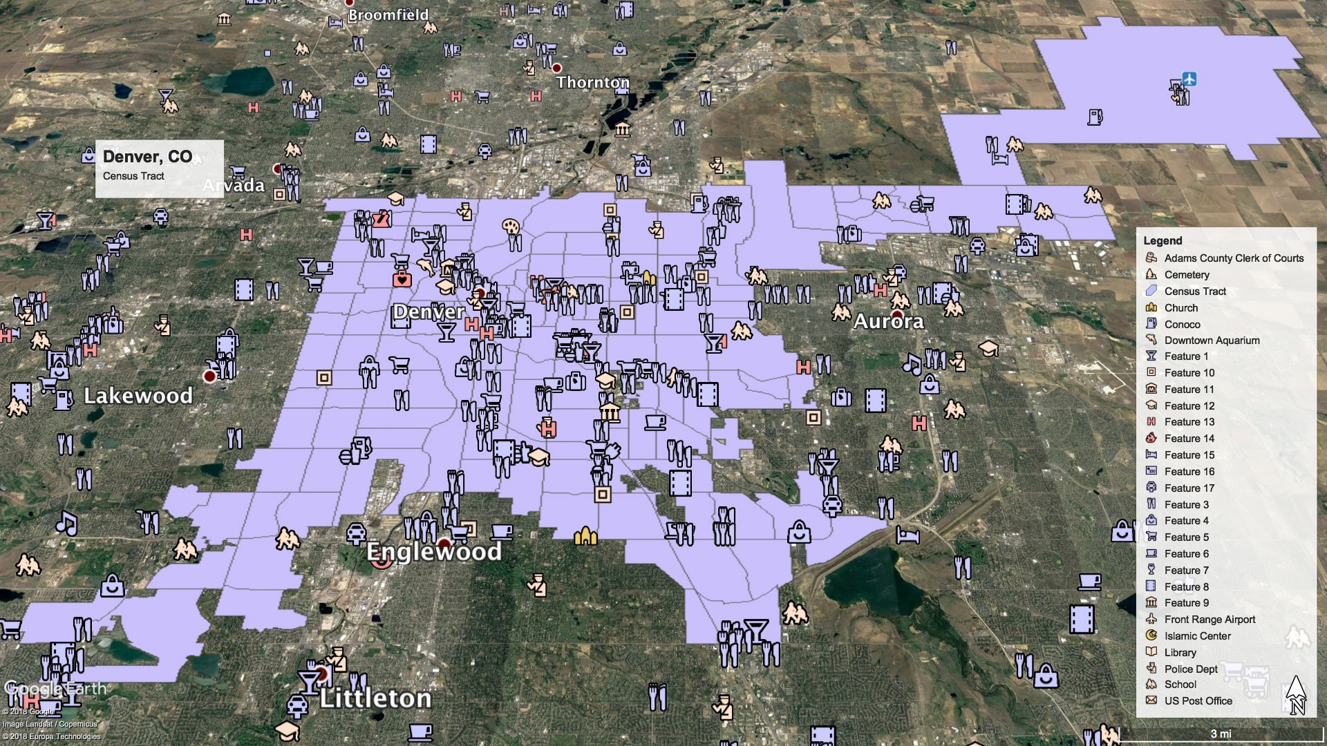

Slide 18
Yelp
Yelp = Business directory + Crowdsourced reviews
Adds thickness to the features of a city
Long(but chequered) history of collecting reviews
We receive only “top” three reviews from Yelp API
Gives us - Business location and characteristics + User (reviewers)
How to get Yelp data?
Simple - There is prepackaged Yelp json files on their website and on Kaggle
Less Simple - Use Yelp API to collect data (That is what we did!)
Notes:
Can I use the Yelp API for academic research?
For years, we’ve provided access to a subset of rich Yelp content through our academic dataset. Jump in and participate in our Dataset Challenge if you’re up to the task! Please also feel free to reach out to api@yelp.com if you have an interesting research project in mind. We’d love to hear from you.

Slide 19
Why Yelp and Google?
Firms that provide business listings and reviews - Yelp, Google, Foursquare, TripAdvisor
Foursquare and TripAdvisor does not provide API access for academic purposes
Yelp provides free access but caps single query to 5000 listings, and three “top” reviews per listing.
We limited our search to 122 parent categories for listings
Google Places API (sub of Google Maps API) provides information on broader set of features
Google Places both supplements (for eg. business listings) and complements (for eg. public transport) Yelp data

Slide 20
# | Data Sources | Unit of Analysis for our purpose | Data Elements | Time-Resolution
1 | AirBnB | Lowest: Individual listing Highest: Census tract | Listing location, listing description, listing reviews Data: 4,686 Listings; 211,206 Reviews | Listing and Review Dates May 2016 - Present
2 | Yelp | Lowest: Business/Place location Highest: Census tract | Business/non-residential place location, description, review (only 3 per place, rated most useful) Data: 11,918 listings; ~30,000 reviews | Review Dates 2005 - Present
3 | Google Places | Lowest: Business/Place location Highest: Census tract | Local features location, description and reviews (only 5 per place, most recent) Approximately 60K places | Review Dates Present
4 | U.S. Census and ACS | Lowest = Highest: Census tract | Demographic & economic features | 10 Years, and 5 Years

Slide 21

Future Analyses
First Analysis
Structural Topic Model (STM) to find Co-variation
Describe and Explore these Connections
Subsequent Directions
Techniques
Deep Learning, Text Networks, Computer Vision
Topics
Segregation, Business Networks, Accessibility

